Slide 1

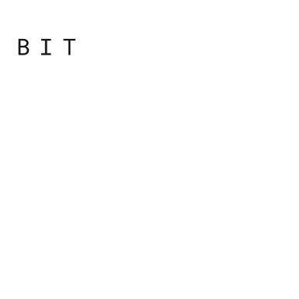
Programming
Principles
with JavaScript

Slide 2

Overview
JavaScript. History. Lexical Structure
Types, Values and Variables
Boolean Logic and Operators

Slide 3
Booleans, Operators in Depth

Slide 4
Booleans
A boolean value represents truth or falsehood, on or off, yes or no
There are two possible values of this type
The reserved words true and false evaluate to these two values
Boolean values are a result of comparison

Slide 5
Logical Operators
There are three operators called logical operators, that work with Boolean values
! – logical NOT (negation)
&& – logical AND
|| – logical OR
When something is not true, it must be false.

Slide 6
Logical Operators
You can convert any value to its Boolean equivalent using a double negation
!!”somestring”
Most values convert to true with the exception of the following, which convert to false
The empty string ""
null
undefined
The number 0
The number NaN
The Boolean false

Slide 7
Logical Operators
These six values are referred to as falsy, while all others are truthy (including, for example, the strings "0", " ", and "false")

Slide 8
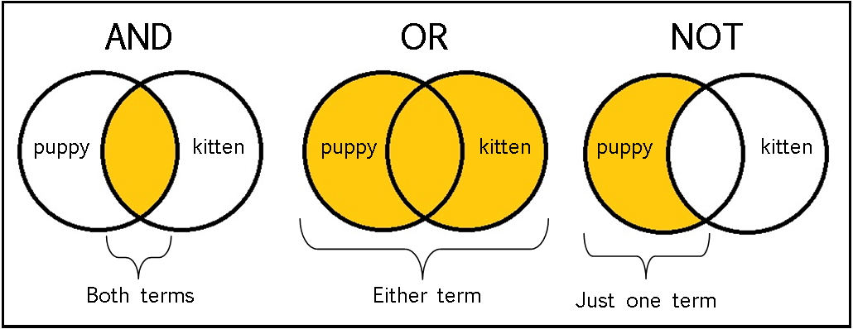
Logical Operators

Slide 9
AND
true && true -> true
true && false -> false
false && true -> false
false && false -> false

Slide 10
OR
true || true -> true
true || false -> true
false || true -> true
false || false -> false

Slide 11
Operator Precedence
false && false || true && true
Notes:
Returns true because of operator precedence. 1 + 2 * 3 = 7 This is because multiplication has higher precedence over addition, so 2 * 3 is evaluated first

Slide 12
Operator Precedence
!(NOT) has the highest precedence and is executed first, assuming there are no parentheses that demand otherwise. Then, in the order of precedence, comes &&(AND) and finally ||(OR)

Slide 13
Operator Precedence
The ECMAScript standard defines the precedence of operators.
Notes:
The ECMAScript standard defines the precedence of operators. While it may be a good memorization exercise, you should not remember it. First of all, you'll forget it, and second, even if you manage to remember it, you shouldn't rely on it. The person reading and maintaining your code will likely be confused.

Slide 14
Lazy Evaluation
If you have several logical operations one after the other, but the result becomes clear at some point before the end, the final operations will not be performed because they don't affect the end result
> true || false || true || false || true
true
Notes:
Since these are all OR operations and have the same precedence, the result will be true if at least one of the operands is true. After the first operand is evaluated, it becomes clear that the result will be true, no matter what values follow. So, the JavaScript engine decides to be lazy (OK, efficient) and avoids unnecessary work by evaluating code that doesn't affect the end result.

Slide 15
Lazy Evaluation
If JavaScript encounters a non-Boolean expression as an operand in a logical operation, the non-Boolean is returned as a result
> true && "something";
"something"
Notes:
This behavior is not something you should rely on because it makes the code harder to understand. It's common to use this behavior to define variables when you're not sure whether they were previously defined.
In the next example, if the variable mynumber is defined, its value is kept; otherwise, it's initialized with the value 10:
> var mynumber = mynumber || 10;
> mynumber;
10

Slide 16
Comparison Operators
There's another set of operators that all return a Boolean value as a result of the operation
== === != !== > >= < <=

Slide 17
Comparison Operators
== Equality comparison
Returns true when both operands are equal. The operands are converted to the same type before being compared. Also called loose comparison. 1 == '1'; true
=== Equality and type comparison
Returns true if both operands are equal and of the same type. It's better and safer to compare this way because there's no behind-the-scenes type conversions. It is also called strict comparison. 1 === '1'; false
Notes:
http://bguiz.github.io/js-standards/img/js-double-equals-truth-table.png
https://i.stack.imgur.com/62vxI.png

Slide 18


Undefined and null
If you try to use a non-existent variable, you'll get an error
Using the typeof operator on a non-existent variable is not an error
Notes:
If you declare a variable without giving it a value, this is not an error

Slide 19
Undefined and null
When you declare a variable without initializing it, JavaScript automatically initializes it with the value undefined

Slide 20
Undefined and null
The null value, is not assigned by JavaScript behind the scenes;
null is assigned by you in code

Slide 21
Undefined and null
Difference between null and undefined is small, but it could be critical at times.
e.g. if you attempt an arithmetic operation, you get different results
null and undefined are converted to the other primitive types in different ways

Slide 22

Practical
Notes:
Starting with the bootcamp
Hoping to catch the wave and achieve much more

